Slide 1
What’s Next: Low-Stress Bike Networks
Peter G Furth
Professor of Civil & Environmental Engineering
Northeastern University

Slide 2
Only a Few People Have a High Tolerance for Traffic Stress
Strong & Fearless
1-3%
Enthused & Confident (7%)
Interested but Concerned (60%)
No Way, No How (30%)

Slide 3
Here’s a bike lane 100% in compliance with American design guidelines. Who does it serve?
Camino del Norte, San Diego. Speed limit is 55 mph.

Slide 4
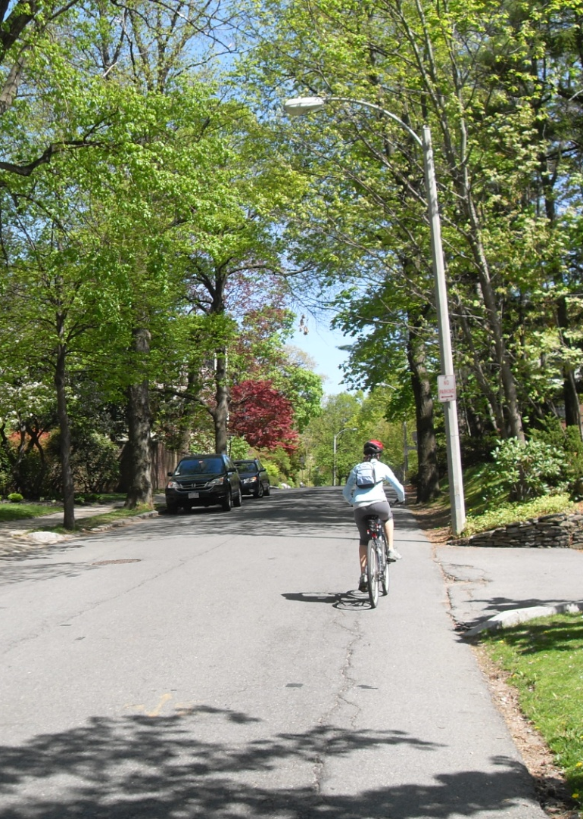
Level of Traffic Stress 1

Slide 5
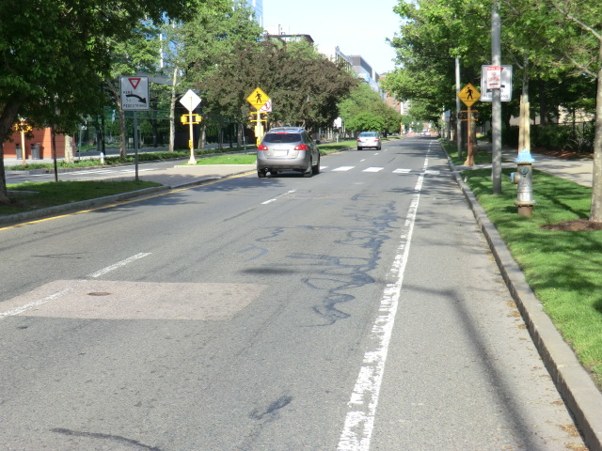
Level of Traffic Stress 2

Slide 6
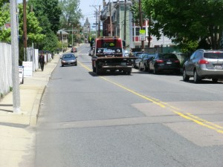
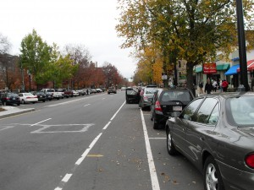
Level of Traffic Stress 3

Slide 7
San Jose Street Network 2012, All Levels of Stress

Slide 8
Stress Level 3 or Less

Slide 9
Stress Level 2 or Less

Slide 10
Stress Level 1

Slide 12
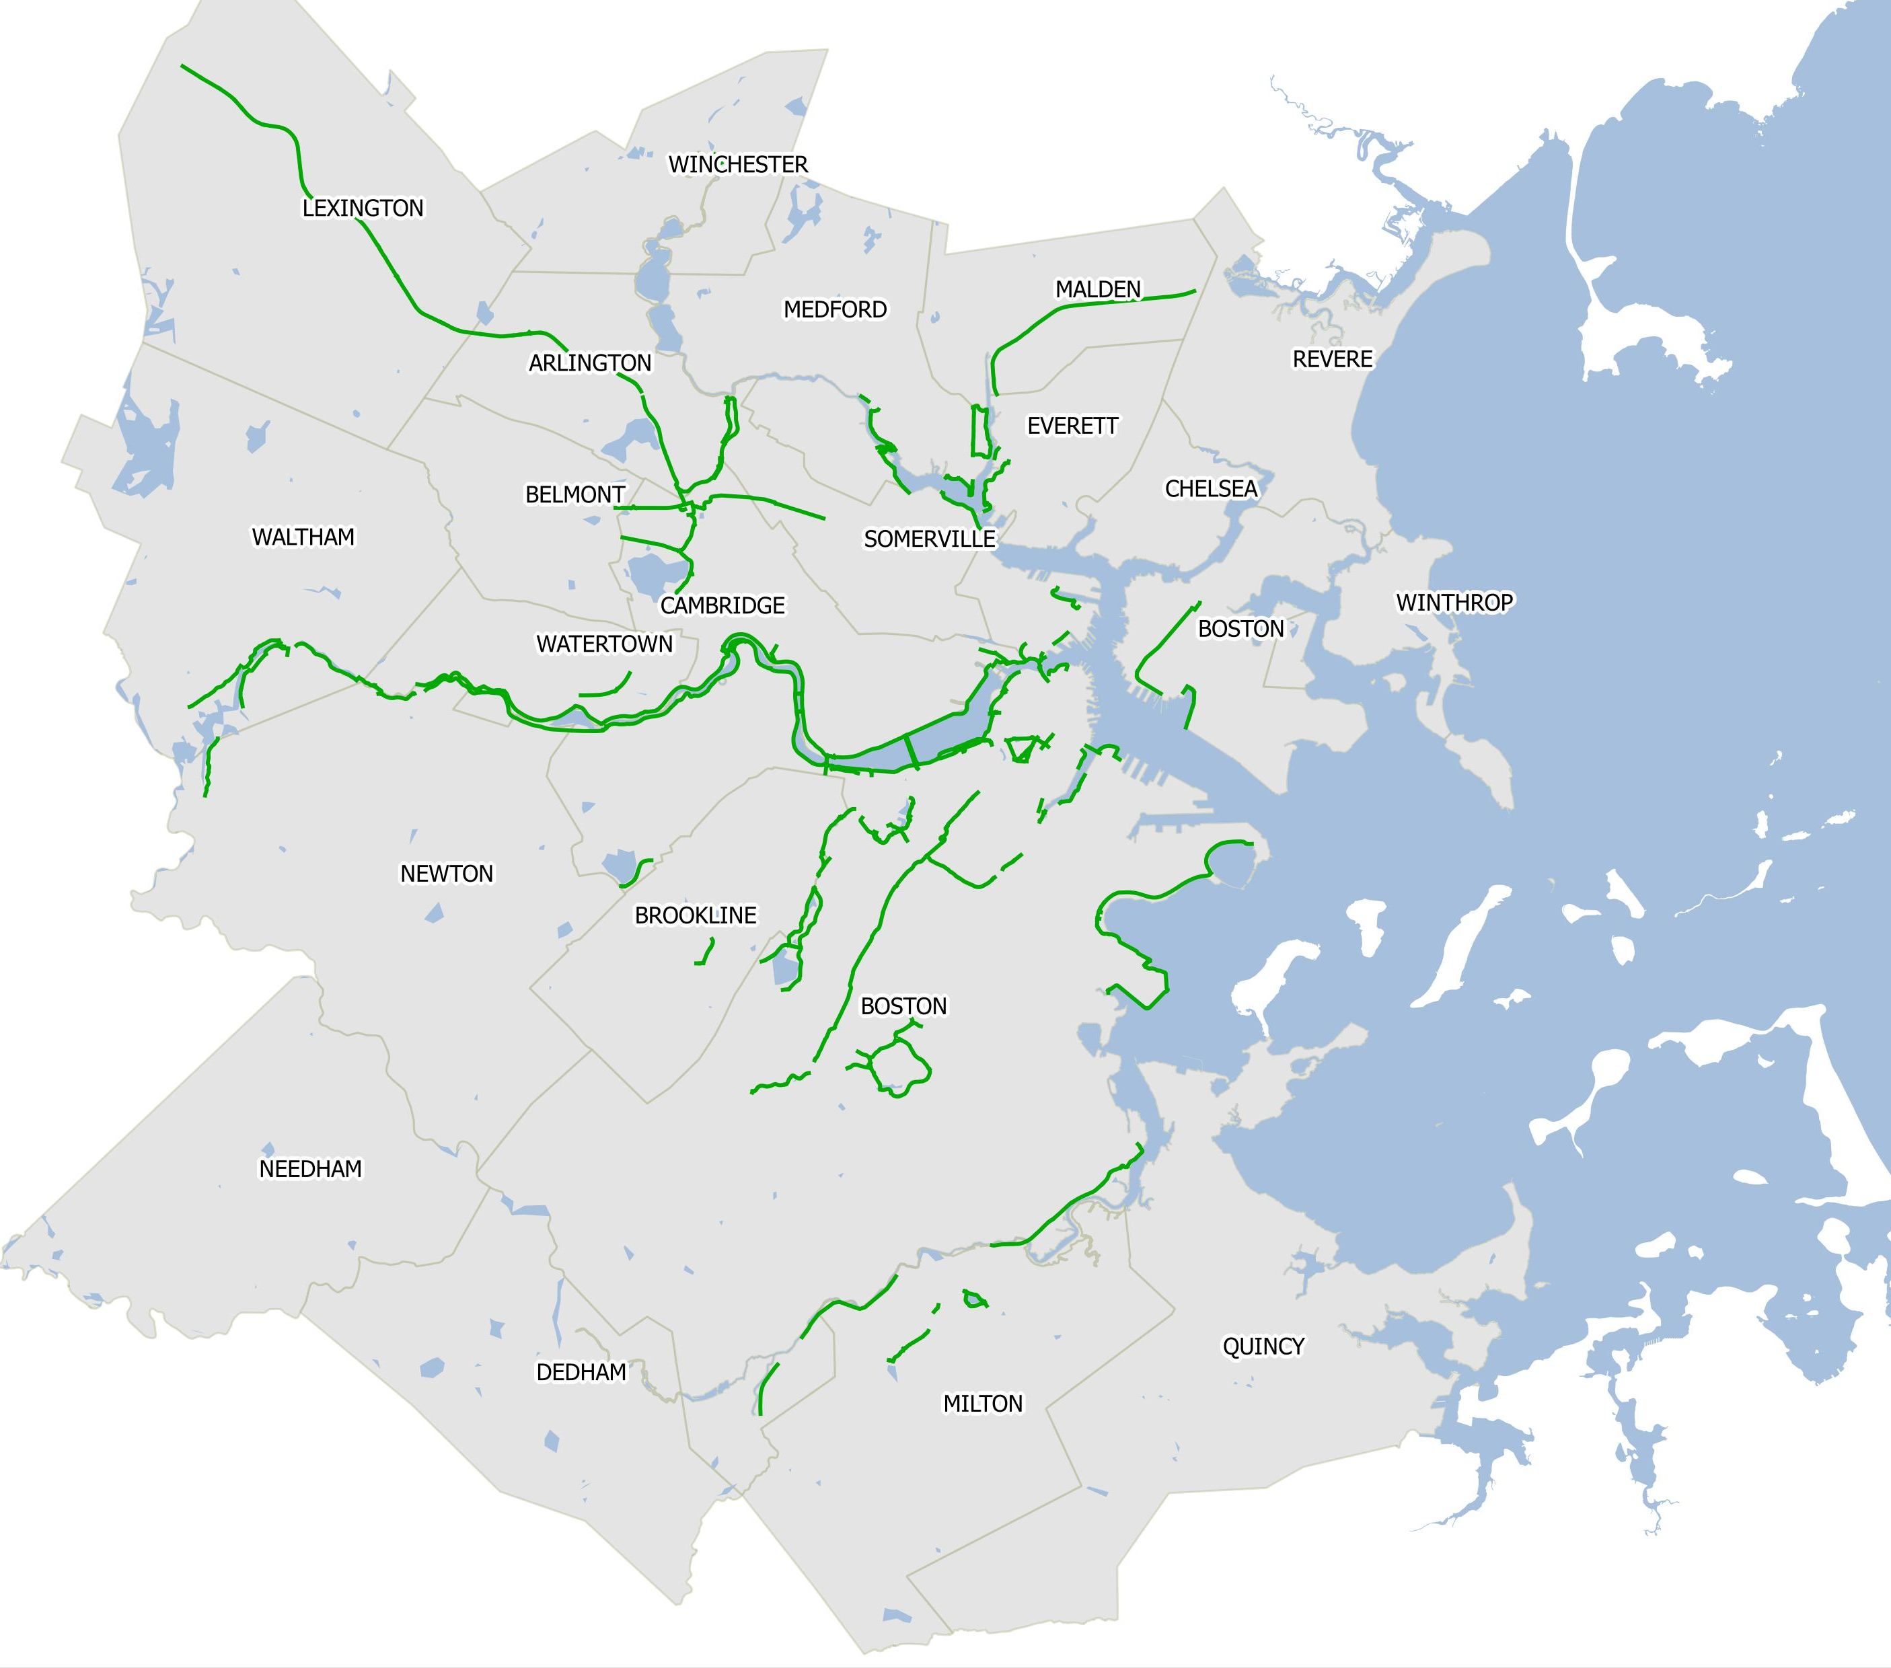
Boston’s Greenway “Network” Today
Minuteman Bikeway
90 miles
Charles River Paths
HarborWalk
SW Corridor Path
Muddy River Path
Only 2% of home-work pairs
connected
Neponset River Greenway

Slide 13
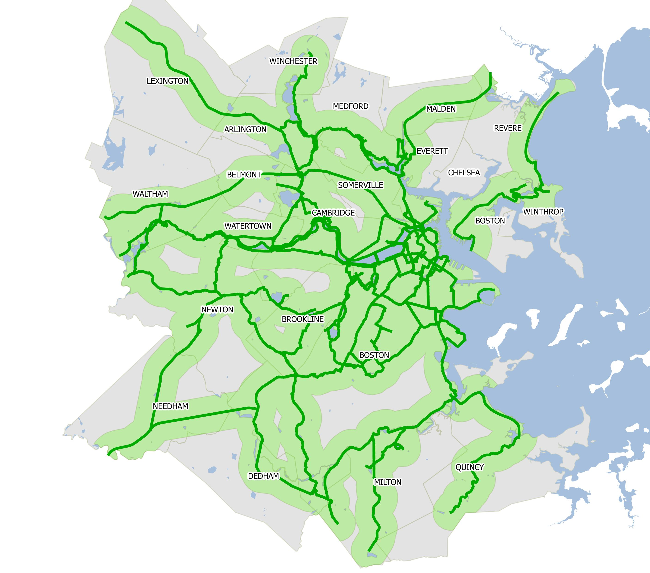
Emerald Network: Our Future!
210 miles
47% of home-work pairs
connected

Slide 14
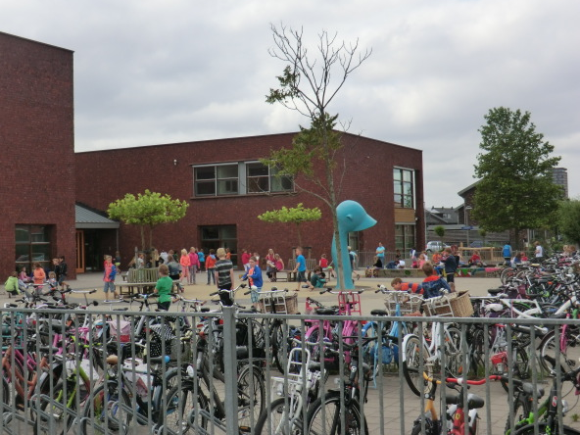
For Healthy Cities, Invest in Low-Stress Bike Networks

