Slide 1
Delay Estimation of Multi‐Stage Pedestrian Crossings
Yue (Danny) Wang
wang.yue3@husky.neu.edu
supervised by Prof. Peter Furth

Slide 2
What HCM says?
Source: HCM 2000, Chapter 18.

Slide 3
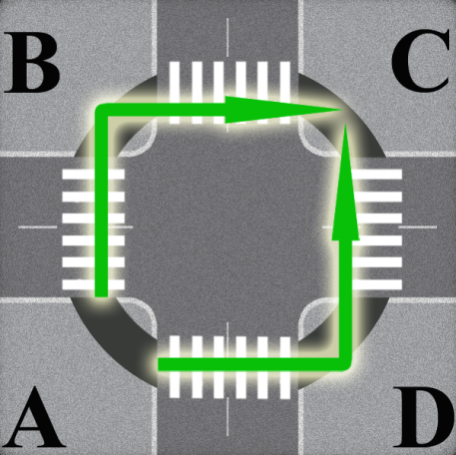
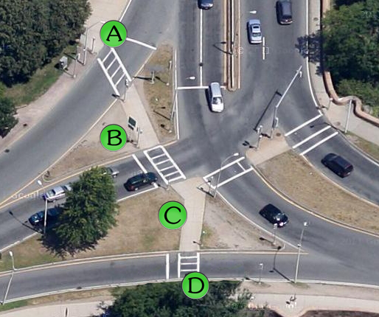
But, what if…
Pedestrians have to cross more than one stage and wait for a WALK in each stage.
There is more than one WALK interval per signal cycle.
Diagonal crossing.
Which way? A-B-C or A-D-C ?
Bikes making two-stage (pedestrian-style) left turns are sometimes allowed to follow one direction only.
Crossing Boylston Street @ Charlesgate West, Boston
Notes:
diagonal crossing in two stages equivalent to two-stages. Moreover, they usually have a choice: A-B-C (clockwise) or A-D-C (counterclockwise? Perhaps always the first to come.

Slide 4
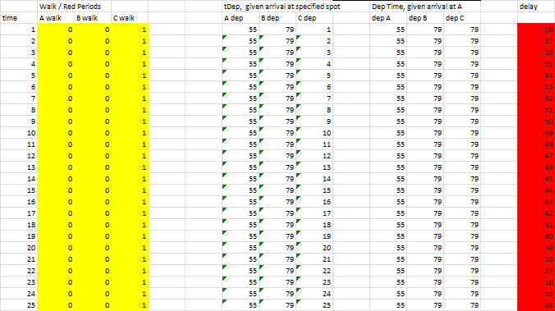
Intuitive and Numerical!

Slide 5
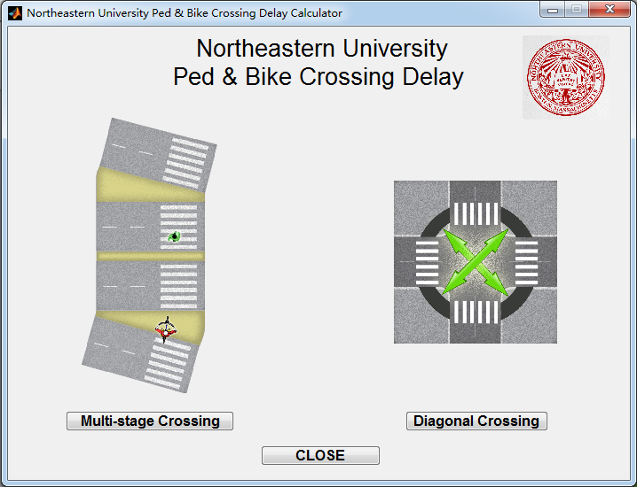
Build a Tool
Research
Engineering
Community

Slide 6
Northeastern University Ped & Bike Crossing Delay Calculator
‘Multi-stage Crossing’
accounts for the crossing where pedestrians or bikes have to cross many stages and wait for WALK interval during each stage.
‘Diagonal Crossing’
accounts for the situation where pedestrians or bikes need to cross the intersection diagonally, and therefore make a two-stage crossing, with path choice.

Slide 7
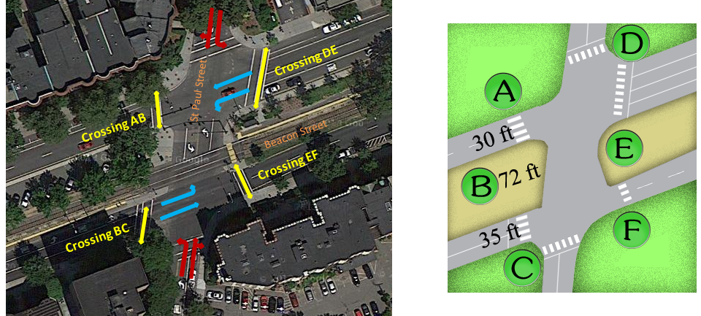
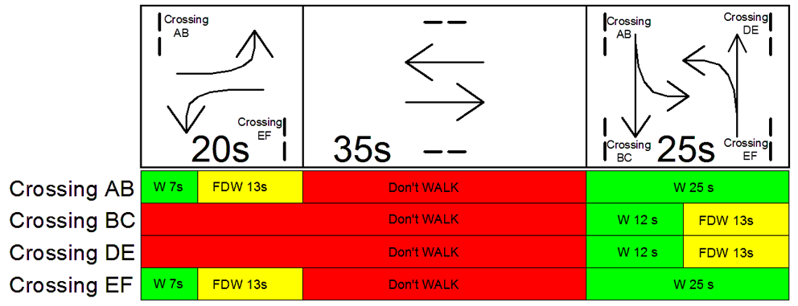
Calculation Example: A two-stage crossing
Signal Timing Plan
Intersection Layout
St. Paul Street @ Beacon Street in Brookline, MA

Slide 8
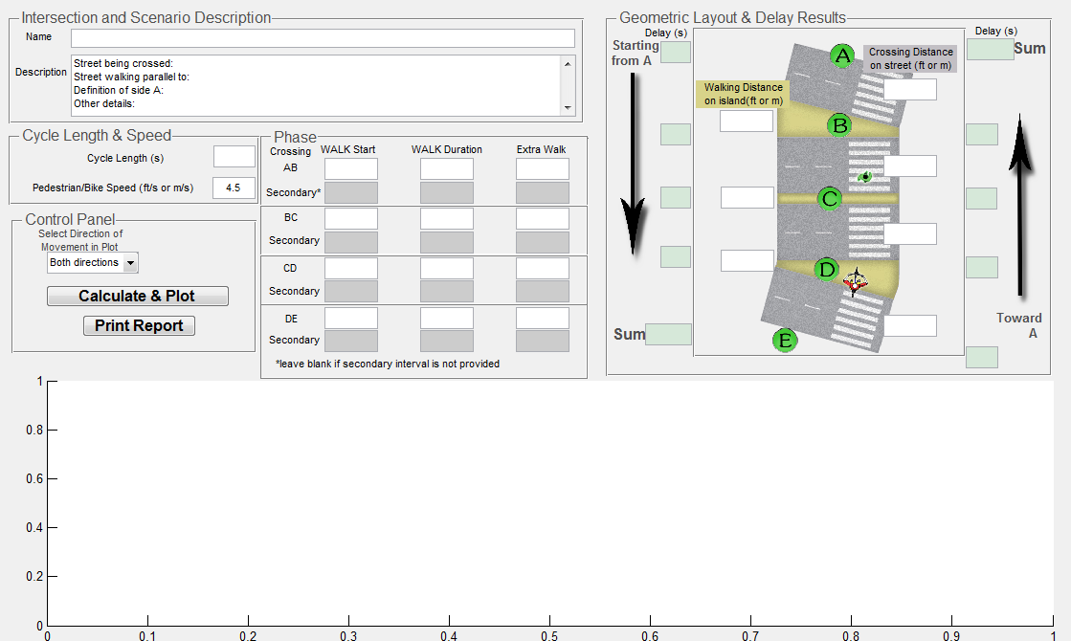
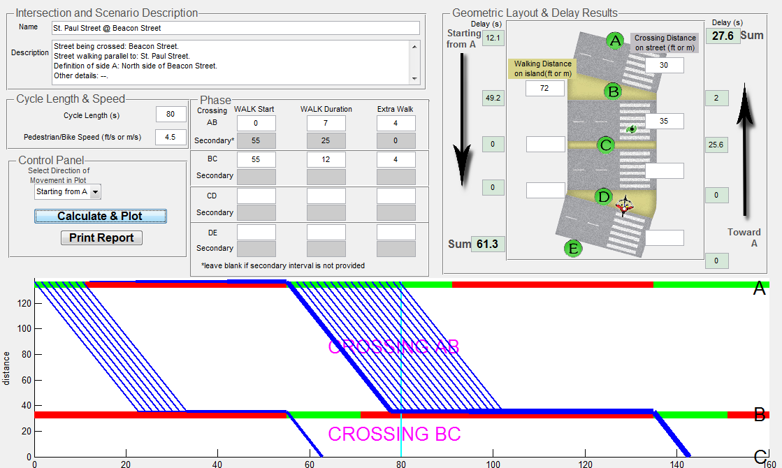
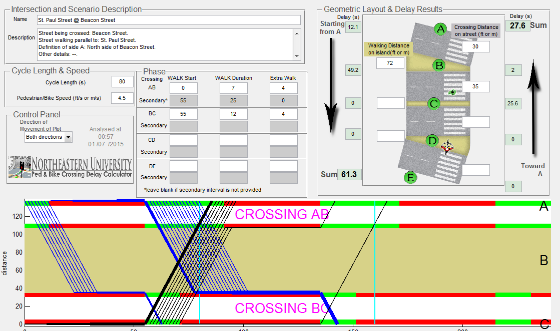
Calculation Report

Slide 9
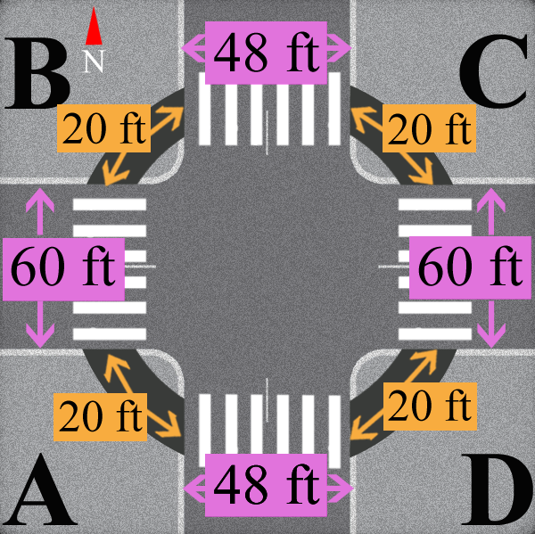
Calculation Example: Diagonal crossing
Signal Timing Plan
Intersection Layout

Slide 10
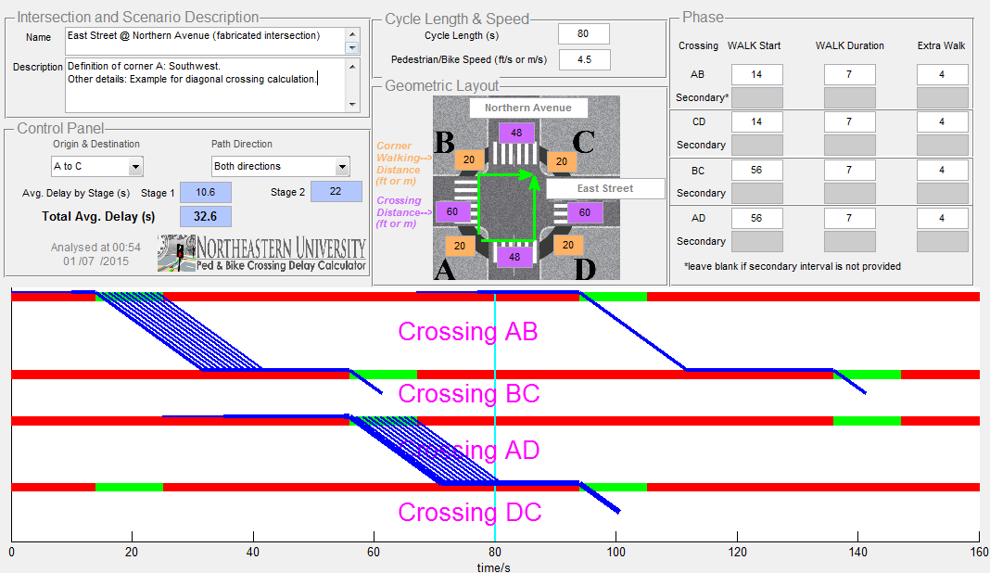
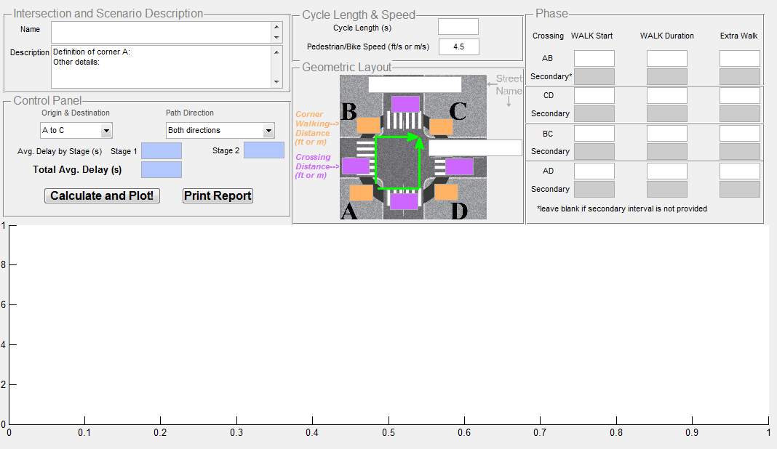
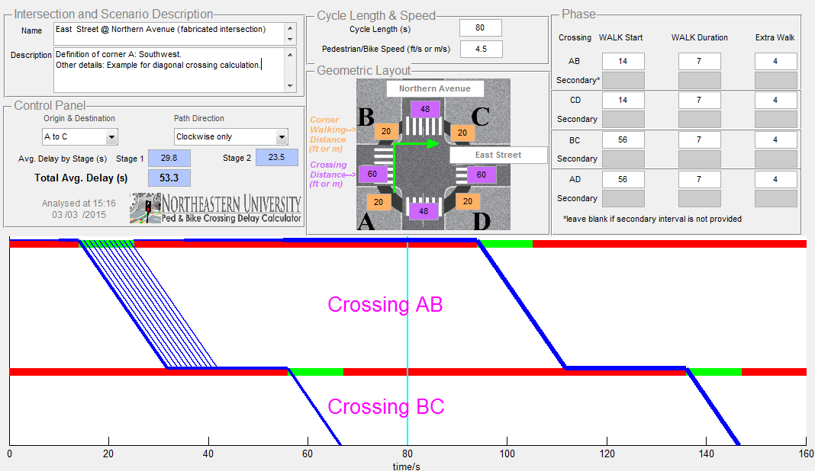
Calculation Report

Slide 11
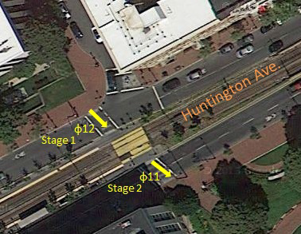
Short Cycle with Offset Crossing Phases
SB
94s
66s
NB
SB
30s
29s
NB
Existing plan.
Proposed plan.
Huntington Ave. @ Opera Pl, Boston, MA.

Slide 12
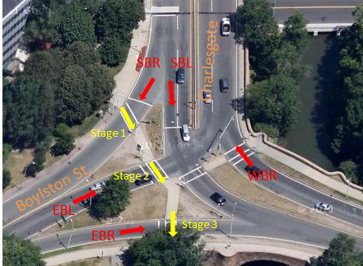
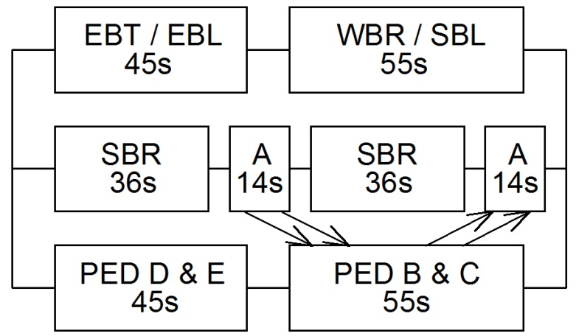
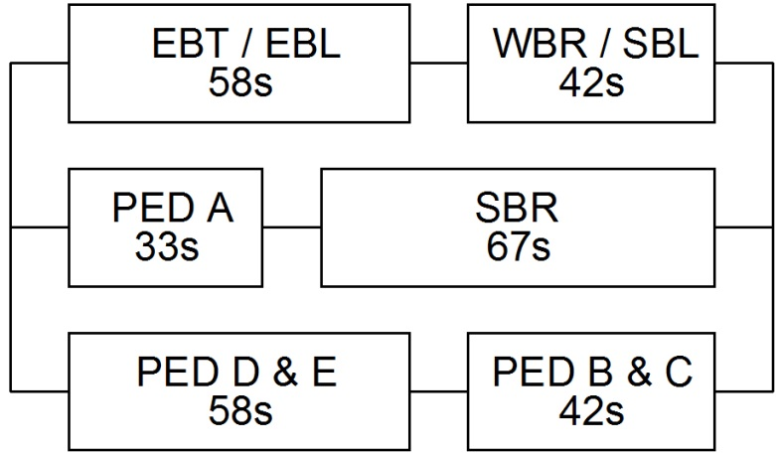
Re-service for Short Crossings
SB
68s
41s
NB
Existing plan.
Proposed plan.
SB
36s
34s
NB
Crossing Boylston St. @ Charlesgate West, Boston, MA.

Slide 13
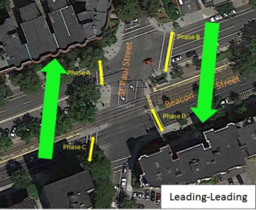
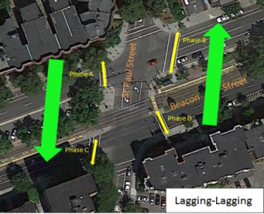
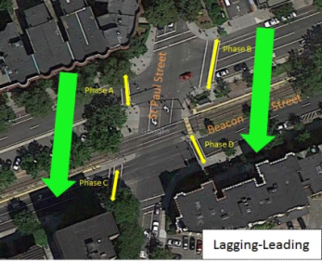
Lead-Lag Sequencing to Facilitate Two-Way Pedestrian Progression
Lead-Lead (EBL-WBL)
Lag-Lag (EBL-WBL)
SB | 61.4 | 31.8 | SB
NB | 31.8 | 61.4 | NB
SB | 31.4 | 66.4 | SB
NB | 66.4 | 31.4 | NB
Lead-Lag (EBL-WBL)
Lag-Lead (EBL-WBL)
SB | 41.4 | 41.4 | SB
NB | 16.2 | 16.2 | NB
SB | 16.2 | 16.2 | SB
NB | 41.4 | 41.4 | NB
St. Paul Street @ Beacon Street, Boston, MA

Slide 14
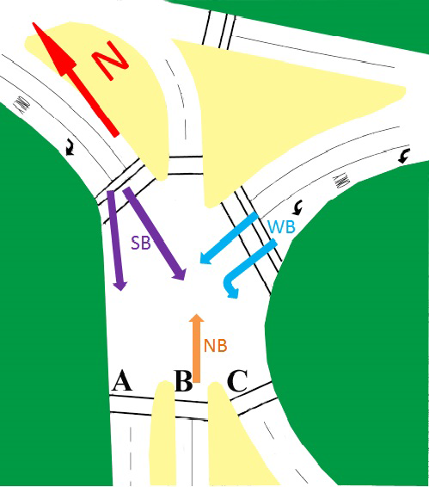
Single Stage Crossing for Bikes with Multi-Stage Crossing for Peds
123s WB
124s EB
Riverway, Landmark, Boston, MA.

Slide 15
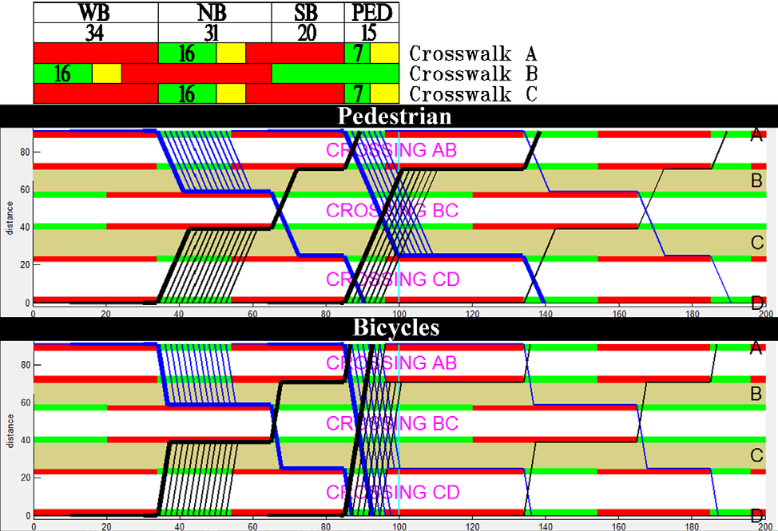
Single Stage Crossing for Bikes with Multi-Stage Crossing for Peds
38s WB
38s EB
44s WB
45s EB
Riverway, Landmark, Boston, MA.

Slide 16
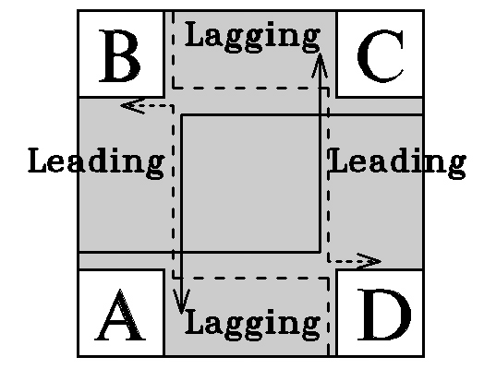
Lead-Lag Sequencing to Facilitate Two-Stage Cyclist Left Turns
NBT
EBT

Slide 17
Thank You!
Northeastern University Ped & Bike Crossing Delay Calculator
and related files could be downloaded at:
http://www.northeastern.edu/peter.furth/delaycalculator/

